Slide 1
Reduce PostgreSQL Costs in the Cloud
Jobin Augustine
PostgreSQL Escalation Specialist

Slide 2


Thanks to
Original Contents
Daniel Guzman Burgos, PMM Tech Lead, Percona
Peter Zaitsev, Founder, Percona
Experience shared by users and customers
Personal views

Slide 3
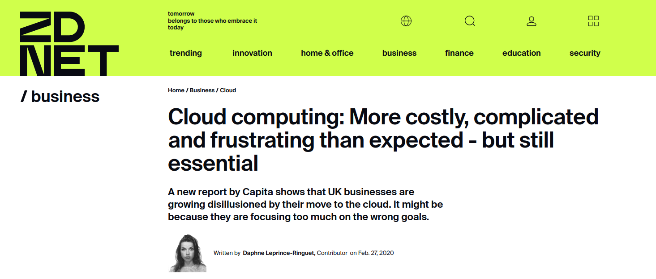
Cloud - Experience
https://www.zdnet.com/article/cloud-computing-more-costly-complicated-and-frustrating-than-expected-but-still-essential/

Slide 4
Cloud Experience
"There has been a sort of hype about cloud in the past few years. Those who have started migrating really focused on cost saving and rushed in without a clear strategy. Now, a high percentage of enterprises have not seen the outcomes they expected."
"Up to 58% of organisations said that moving to the cloud has been more expensive than initially thought"
"80% of organisations will overshoot their cloud infrastructure budgets because of their failure to manage cost optimisation."

Slide 5
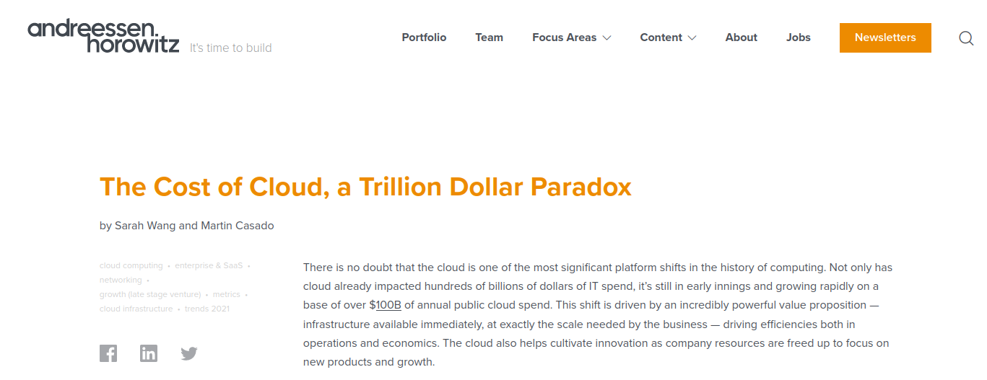
“the pressure it puts on margins can start to outweigh the benefits, as a company scales and growth slows. Because this shift happens later in a company’s life, it is difficult to reverse as it’s a result of years of development focused on new features”
https://a16z.com/2021/05/27/cost-of-cloud-paradox-market-cap-cloud-lifecycle-scale-growth-repatriation-optimization/

Slide 6
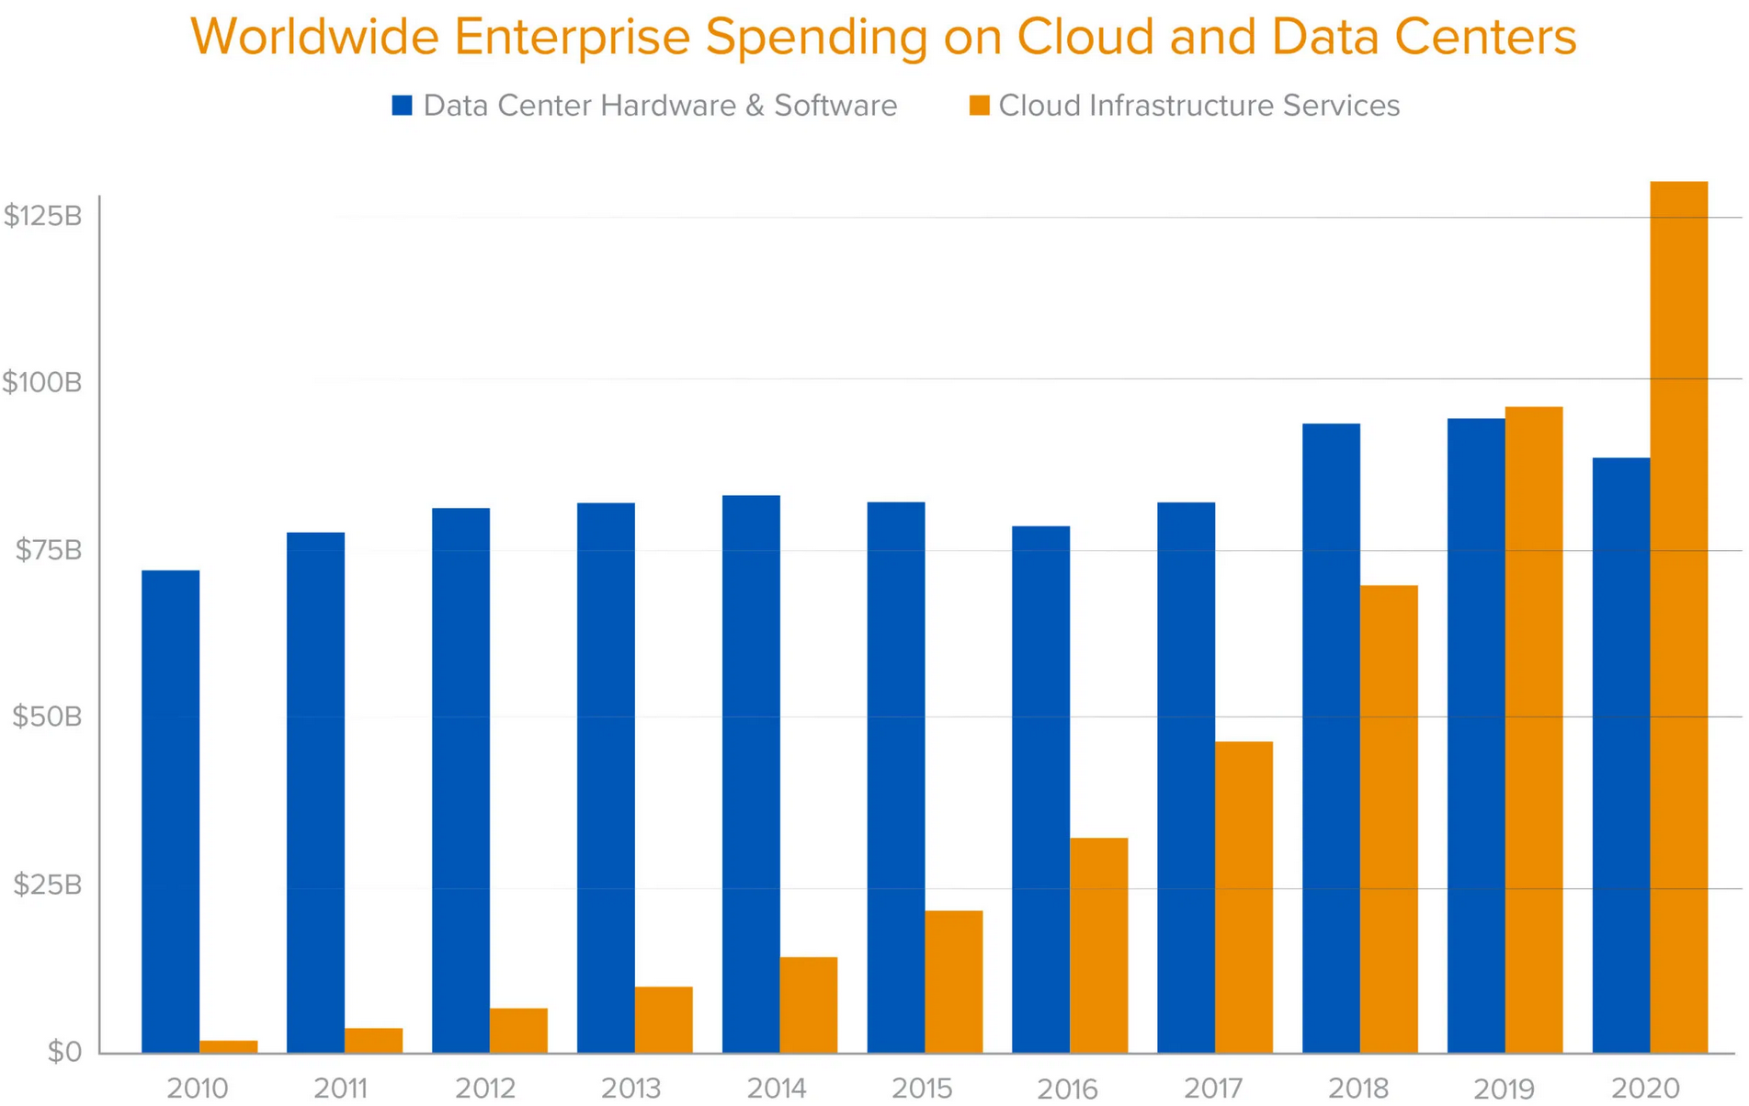
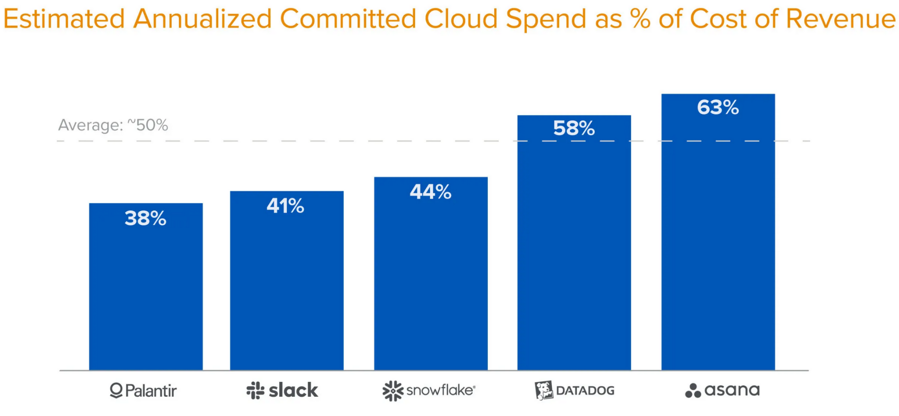
"some companies have taken the dramatic step of “repatriating” the majority of workloads."
Cloud spend amounted to 81% of COR is reported

Slide 7
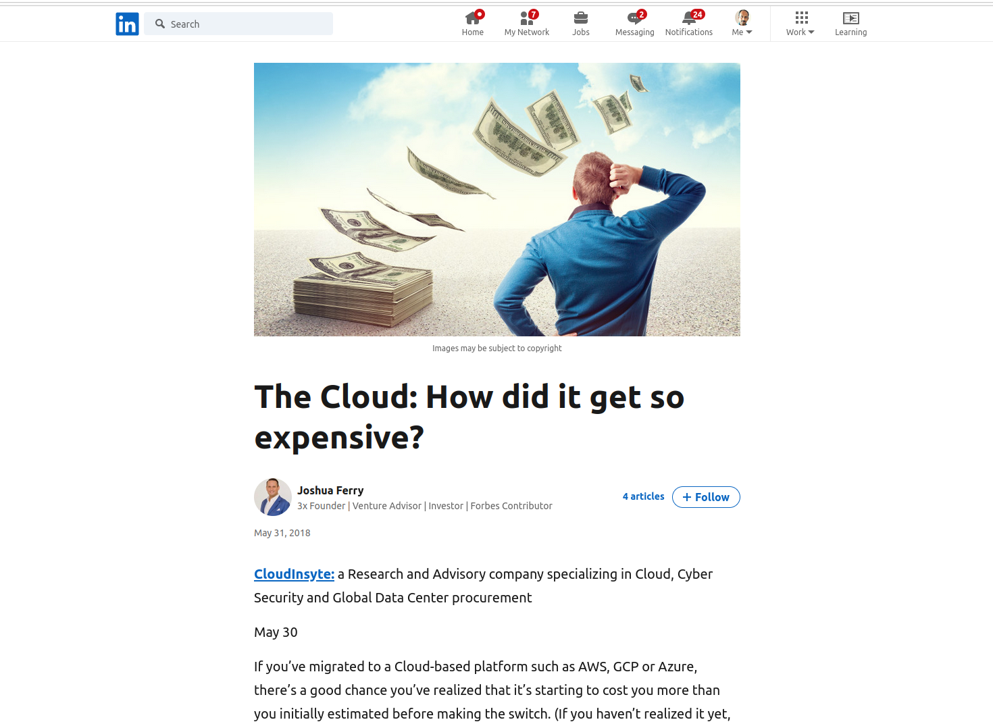

Slide 8
How it started?

Slide 9
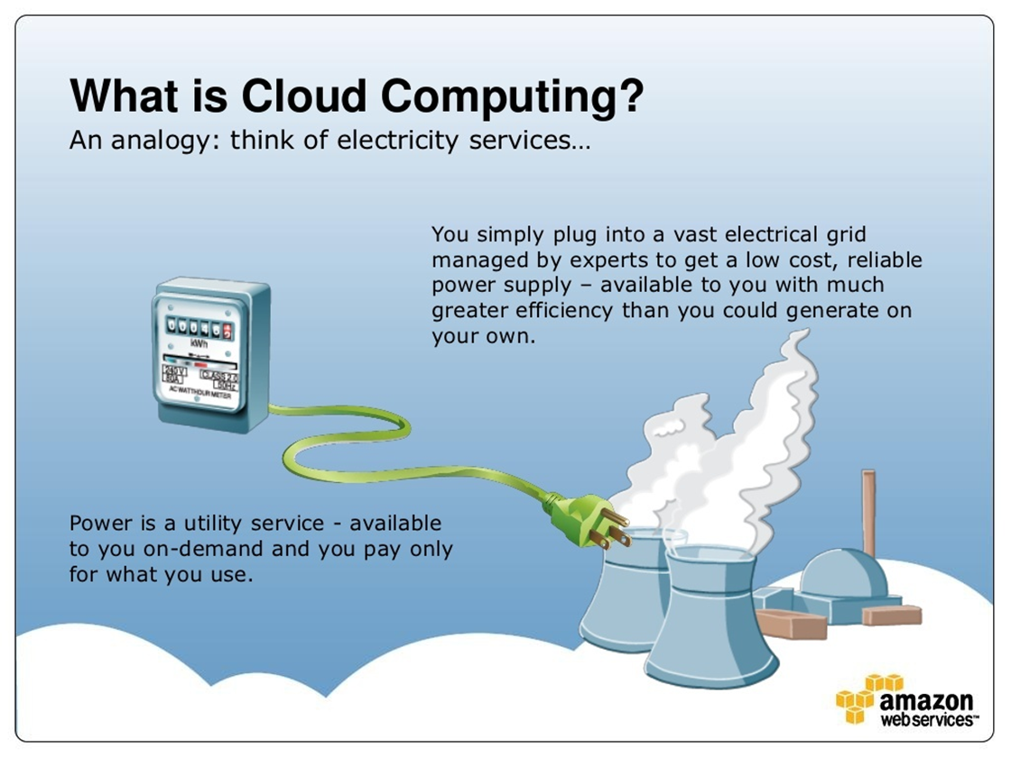
(Early AWS Presentations promoting the cloud)
Programmable, instantly accessible infrastructure comes with so much flexibility. It allows new deployment and management approaches we could not even have imagined in the “old world.”

Slide 10
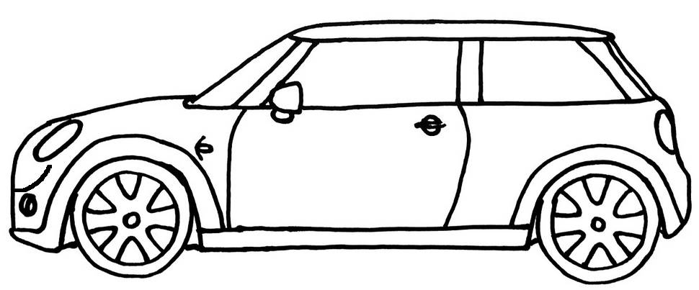
Big Gains
Commoditized the Datacenter, Easily accessible for everyone just like Electricity, Mobile Network
Reduced the provisioning time to negligible.
Reduced the Capex
Acquire only when it is required and let it go.
TAXI

Slide 11

Long term
Commoditization brings easy competition - Eg. Web hosting
Reduced margin for providers
Providers promotes proprietary services
Increased Opex for users. Bad times becomes more painful.
Acquired, But sticky and not easy to release
TAX?
office
Notes:
Things we acquire becomes sticky. What to migrate from Oracle but could not. Want to upgrade, but could not.
Stickiness is evil. it is where things starts get into lock-ins

Slide 12

Marketing proprietary software and Services
“We have a better software better than PostgreSQL, We call it XYZPostgreSQL”
“Community Edition”, “Vanila PostgreSQL”
“We have XXX times faster than PostgreSQL”
“Its fully managed, So you need less people/resources to manage”
Certifications / Courses are used for proprietary software/service marketing.

Slide 13
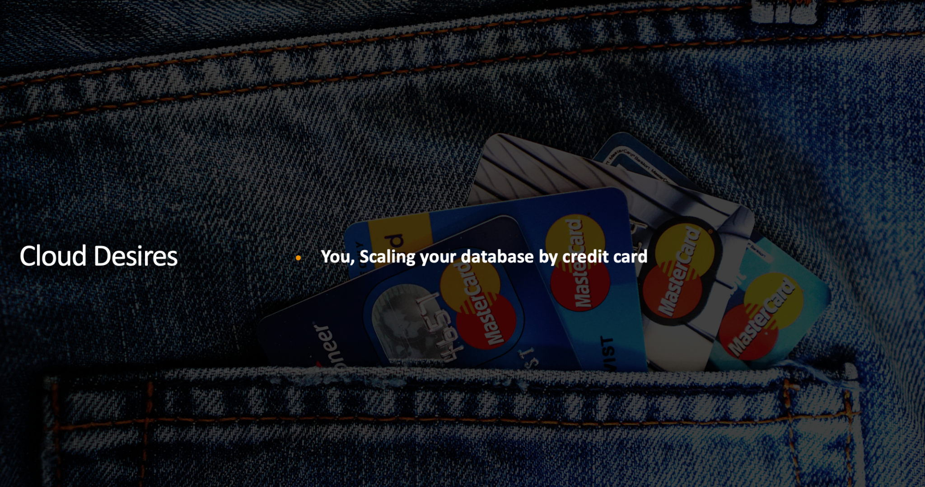

Slide 14
When you are running at scale in cloud
You can almost guarantee that there’ll be some underutilized or forgotten resources.
When faced with the apparently limitless resources in cloud, most engineers will tend to go for the larger resources.
Making that choice often keeps them from getting paged in the middle of the night.
Notes:
Its very common to see cloud instances, especially non-production ones utilized only 4-5 hours.
Shutting down cloud instances used for non-production is not practical.. people even forgets to switchoff lights in bathroom.

Slide 15
Usage Reduction Challenges
It can be difficult to know which resources need reviewing.
It requires that teams have the right metrics to understand their application’s requirements.

Slide 16
What can we do?
Notes:
We - means Victims

Slide 17
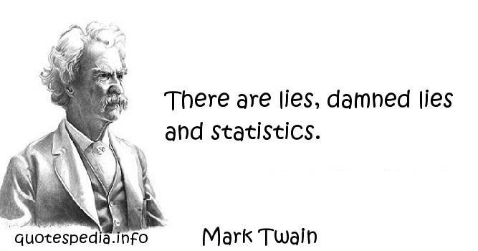
Stage 1. Approach to Cloud
Critical about claims
Test the waters
Aware about the marketing and conflict of interests
Benchmark the own workload.
Load / Performance testing.
Synthetic benchmarks
Notes:
Being Aware about the problem is what matters.

Slide 18
Approach to Cloud
There is not one-time fix
Requires a cultural Shift
Engineers to think of cost
Notes:
Engineers better understand the No. of CPU , RAM and Bandwidth

Slide 19

Stage 2. Identifying the wastage / over-spending
Monitoring - usage vs unused
Assessing cost vs value of proprietary softwares / solutions.
Engaging the experts.
Are we locked up ourselves?

Slide 20
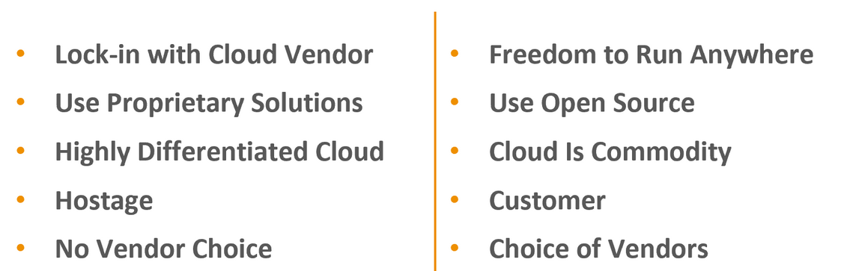
Stage 3. Identifying lock-ins
Notes:
Lock-in vs Freedom.
Is your cloud vendor capable of your business down forever?
Remaining as a “customer” of cloud is important. because customer is the king.

Slide 21
Stage 4. Addressing the Wastage
Decommissioning under utilized
Multi-Cloud approach - Are we ready?
Hybrid approach - Are we ready?
Jailbreaking & Right-sizing

Slide 22
Jailbreaks
IaaS vs DBaaS
Architectures
Custom disk configurations
Baremetal , VMs , Containers/Kubernetes
Multiple cloud vendors
Gaining full control over your assets

Slide 23
Evaluation of Options
Cloud vendors
IaaS vs DBaaS
x86 vs ARM
Intel vs AMD
Instance types
Storage Options
Tablespaces
Splitting of I/O
Notes:
Can you name 5-10 cloud providers?
Storage options.. Storages which scales as per size Vs Storage with assured performance. after a certain size, the storage volume, the cheaper option becomes more effective. with comparable performance.
Assured performance disks often reported stalls.

Slide 24




Example : ARM based processors in cloud
Graviton
Ampere Altra A1
https://www.percona.com/blog/postgresql-on-arm-based-aws-ec2-instances-is-it-any-good/
Notes:
15-20% gains are easy 30-40% savings !

Slide 25


Multi Data Center
Multi - DC deployments are costly
Standby on another datacenter

Slide 26
RIGHT SIZING DATABASE INFRA
Identifying bottlenecks and fixing
Identifying inefficiencies.
Identifying wastages
Improving the schema
Tuning at different levels.
Host hardware
Host OS for database workload
PostgreSQL Instance
Sessions and connection management
Schema
SQL statements
Notes:
Inefficiencies caused by poor designs - Avoidable transaction blocks.
Improving schema - Example Partitioning tables and assessing overhead of foreign keys

Slide 27
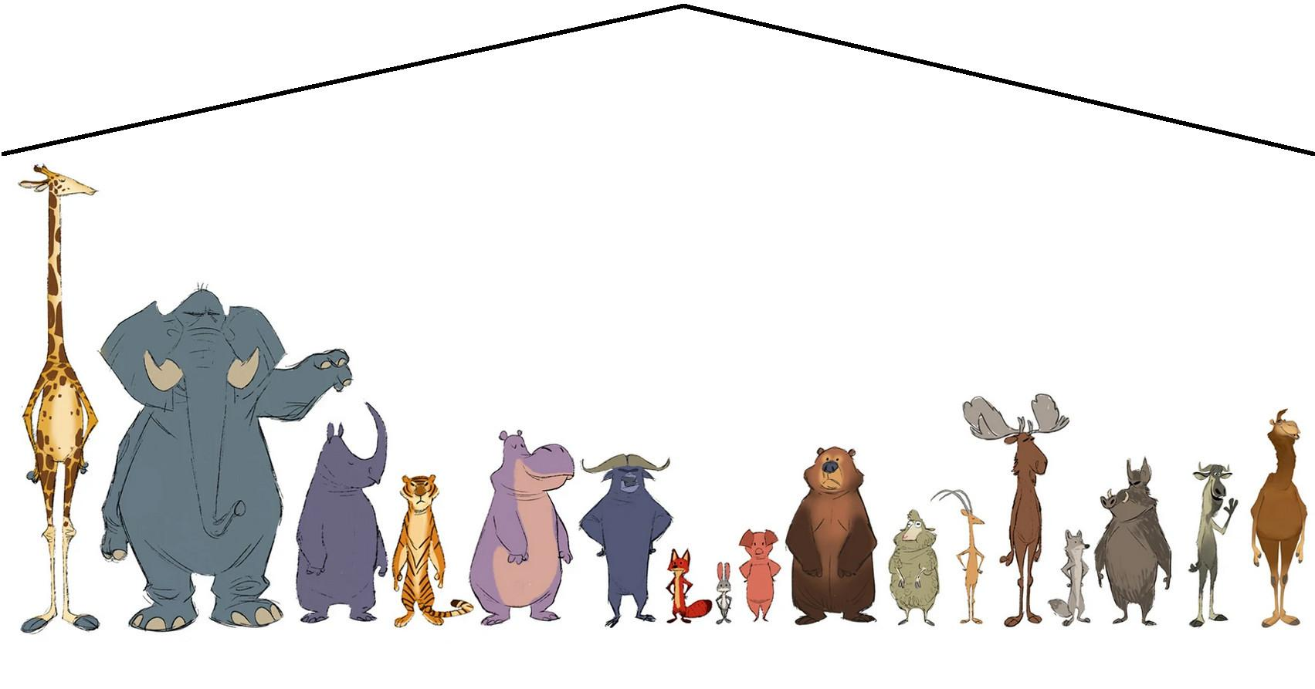
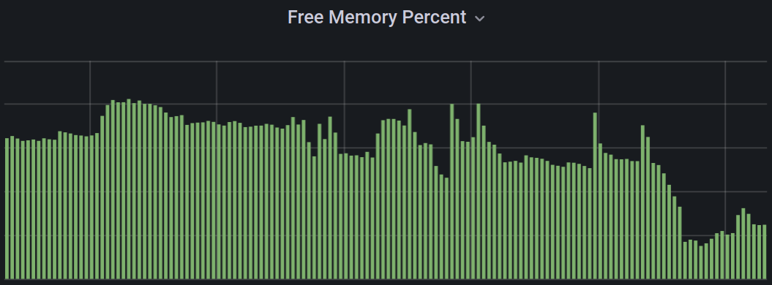
Load - Spike vs Spreading
Procuring for the peak load = wastage
Cloud charges are independent of server resource usage.
Backups
ETL jobs
Table Vacuum and analyze

Slide 28
Example : Scheduled vacuum
WITH cur_vaccs AS (SELECT split_part(split_part(substring(query from '.*\..*'),'.',2),' ',1) as tab FROM pg_stat_activity WHERE query like 'autovacuum%')
SELECT 'VACUUM FREEZE "'|| n.nspname ||'"."'|| c.relname ||'";'
FROM pg_class c
JOIN pg_namespace n ON c.relnamespace = n.oid
LEFT JOIN pg_class t ON c.reltoastrelid = t.oid and t.relkind = 't'
WHERE c.relkind in ('r','m') AND NOT EXISTS (SELECT * FROM cur_vaccs WHERE tab = c.relname)
ORDER BY GREATEST(age(c.relfrozenxid),age(t.relfrozenxid)) DESC
LIMIT 100;
\gexec
20 11 * * * /full/path/to/psql -X -f /path/to/vacuumjob.sql > /tmp/vacuumjob.out 2>&1
https://github.com/jobinau/pgscripts/blob/main/vacuumjob.sql
https://www.percona.com/blog/importance-of-postgresql-vacuum-tuning-and-custom-scheduled-vacuum-job/

Slide 29
TCO - Measure the cost
Number of people to manage
Cost of migration till upgrade
Specialized skills required.
Time to fix problems
Freedom to tune
Cloud Opex cost
Notes:
Time to fix problem : logical replication was stuck asking for missing WAL. DBaaS solution don’t have a option to restore WAL from backup.

Slide 30
Effective Meaning
“fully managed” = “Limited freedom. you can't improve it / fix it”
“Pay as you use” = “Going to pay heavy as the usage increases”
Notes:
Think about the Taxi service

Slide 31
Managed Databases & Unmanageable Troubles
Notes:
I am going to go through some of the major pain points, Disability and wastage of time and money we saw with customers

Slide 32
PostgreSQL Upgrade
No more pg_upgrade

Slide 33
2. No more Tablespaces
All partitions on same disk
No specific file system possible
No compression on storage

Slide 34
3. Segregation of Disks not possible
Dedicated WAL mount not possible
PG logs

Slide 35
4. Connection pooler on DB Host not possible
No option for additional components on DB host

Slide 36
5. Limited Extensions
No columnar store
Sharding solutions
Timescale

Slide 37
6. More time and Effort required
Example, Parameter change

Slide 38
7. Development scope
pl/Python, C, C++

Slide 39
8. Disaster Recovery Site
No switchover and Switchback

Slide 40
9. Logical replication slot continuity
Easy to do with Patroni

Slide 41
10. Customization & In-depth troubleshooting
Custom Dictionary for text search
Notes:
Lot more : Restore of a WAL file

Slide 42
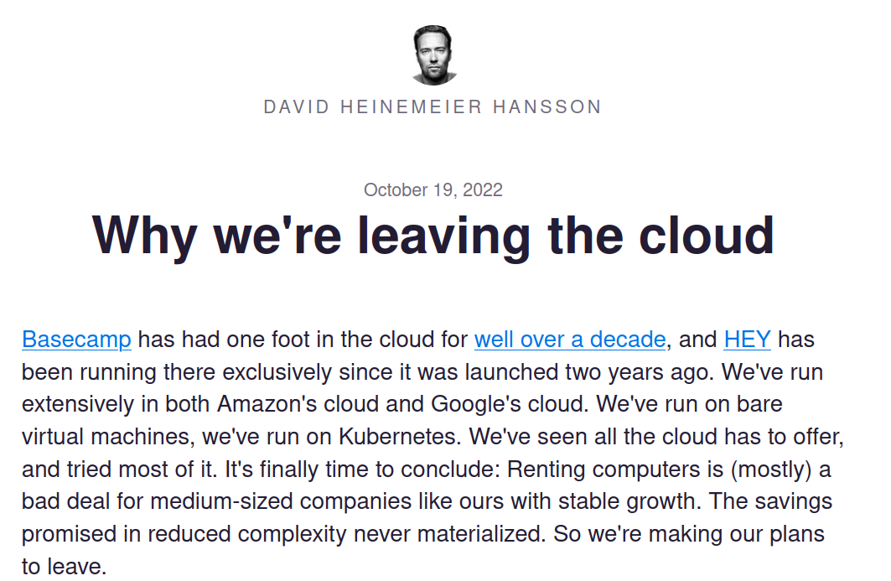
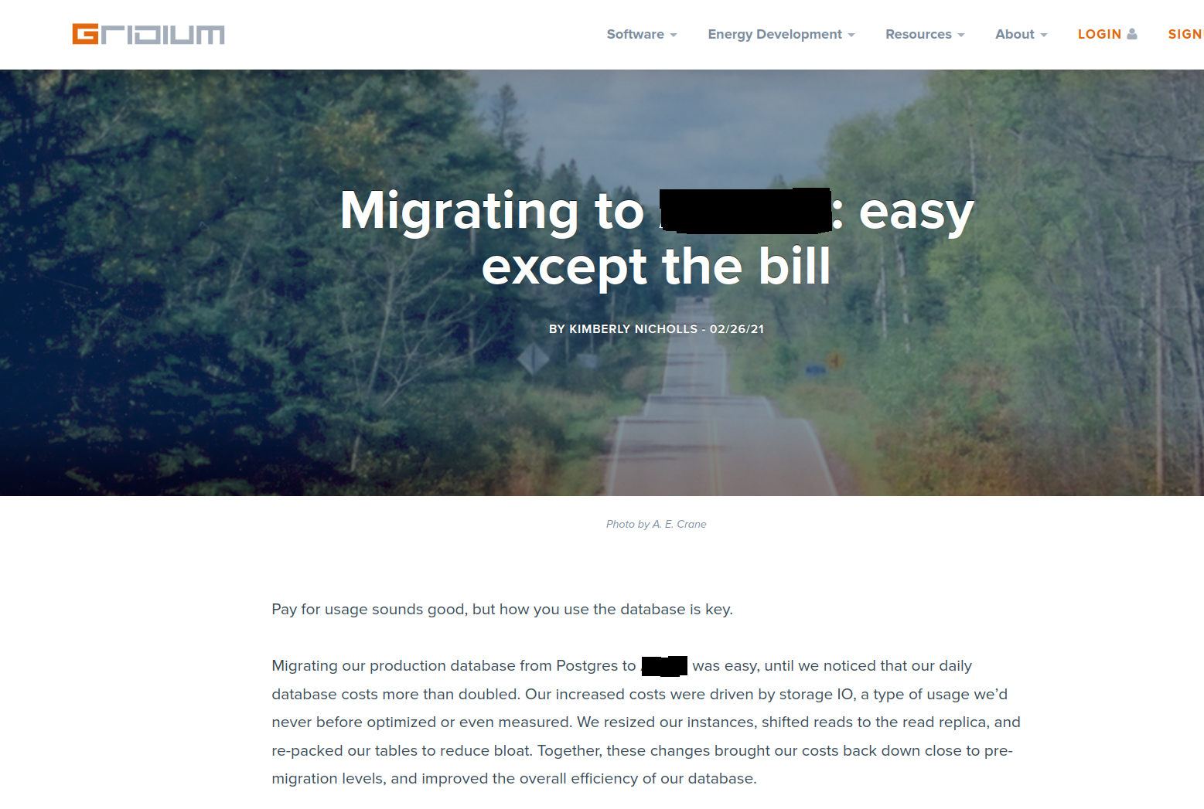
“It's like paying a quarter of your house's value for earthquake insurance when you don't live anywhere near a fault line”
“I've yet to hear of organizations at our scale being able to materially shrink their operations team, just because they moved to the cloud.”
“We're paying over half a million dollars per year for database and search services… Do you know how many insanely beefy servers you could purchase on a budget of half a million dollars”
https://world.hey.com/dhh/we-stand-to-save-7m-over-five-years-from-our-cloud-exit-53996caa
Notes:
paying for assumed scalability.

Slide 43
Everything in cloud is not too costly
Storage services are cheap
Local storage is good.
Assessing the value becomes more important
Avail the cost saving features offered by cloud providers
Spot instances
Long term contracts - Reserved
Severless for occasional load.
Cloud Offerings with I/O billable
Higher Instances may become effectively cheaper - active dataset fits in memory
Database optimization pays off
Multi-tenancy on same host
Notes:
There are things in cloud services with less margin and very high margin. pick the right ones. Few cloud providers gives option for exchanging the contracted instance. In Percona we use single test server by all support engineers.

Slide 44
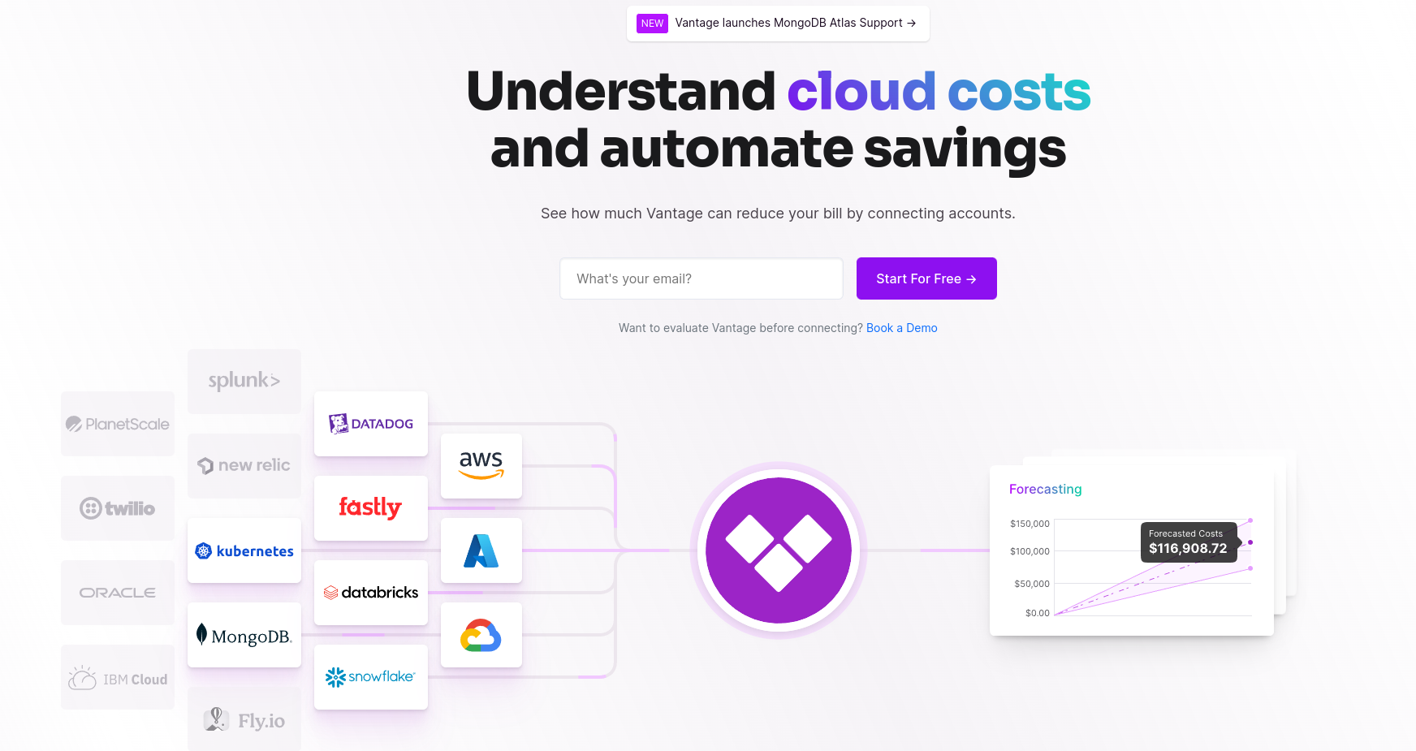
Services for cost optimization.
Notes:
vantage.sh

Slide 45
Summary
Analyzing the bill
workload analysis
Right-sizing exercise
PostgreSQL is easy to setup and maintain.
Resource optimization at different levels.
Underutilized servers
Making informed decisions.
Query optimization.
Schema optimization
Connection management
Application behavior analysis.
Notes:
We have many customers reduced the instance type after the necessary optimization.
Resource optimization at different levels : Starting from the usage of the servers, Till query optimization, Schema optimization and application behaviour correction can save lot.

Slide 46
Important Takeaways
Cost - Opex
Beware of lock-ins
Strong Marketing
Keep multi-cloud always open
IaaS may give better value
Monitoring and assess for optimization

Slide 47


Slide 48
THANK YOU!
percona.com

Slide 50
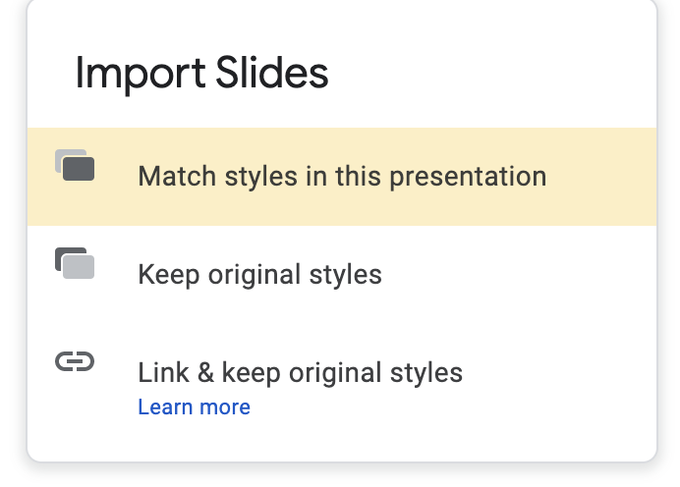
Importing slides from another slide deck
When importing another slide or slides to this presentation, please choose the option: Match styles in this presentation

Slide 51
Colour/Color Palette
#0e1a53
#5e6686
#ff7e1a
#ffc496
#f24500
#f9a98a
#1486ff
#93c7ff
#f0b336
#f8dca3
#30d1b2
#a0eadc
#a86fef
#d7bdf8
#697793
#bac0cd

Slide 52
Poppins Bold 25
Poppins Bold 25
Poppins Bold 25
Poppins Semibold Size 12
Poppins Semibold Size 12
Poppins Semibold Size 12
Poppins Normal size 13
Poppins Normal size 13
Poppins Normal size 13
Poppins Normal size 13
Poppins Normal size 13
Poppins Normal size 13
Poppins Normal size 13
Poppins Normal size 13
Poppins Normal size 13
Poppins Normal size 13
Poppins Normal size 13
Poppins Normal size 13
Poppins Normal size 13
Poppins Normal size 13
Poppins Normal size 13
Poppins Normal size 13
Poppins Normal size 13
Poppins Normal size 13
Poppins Normal size 13
Poppins Normal size 13
Poppins Normal size 13
Poppins Normal size 13
Poppins Normal size 13
Poppins Normal size 13
Poppins Normal size 13
Poppins Normal size 13
Poppins Normal size 13

Slide 53
Poppins Medium Size 34
Poppins Semibold Size 18
Poppins Normal size 13
Poppins Normal size 13
Poppins Normal size 13
Poppins Normal size 13
Poppins Normal size 13
Poppins Normal size 13

Slide 54
Timeline
January
February
March
Mid-March — Mid-April
April
Poppins Semi Bold Size 14
Poppins Semi Bold Size 14
Poppins Semi Bold Size 14
Poppins Semi Bold Size 14

Slide 55
Databases run better with Percona

Slide 56
Poppins Medium S48
Poppins Normal Size 20

Slide 57
Poppins Bold Size 17
Poppins Bold Size 17
Poppins Normal 12
Poppins Normal 12
Poppins Bold 24
Poppins Normal 16
=
Poppins Bold Size 17
Poppins Bold Size 17
Poppins Normal 12
Poppins Normal 12

Slide 58
Poppins Medium Size 34
Poppins Semibold Size 18
Poppins Normal size 13
Poppins Normal size 13
Poppins Normal size 13
Poppins Normal size 13
Poppins Normal size 13
Poppins Normal size 13

Slide 59
Poppins Medium Size 34
Poppins Normal size 11
Poppins Normal size 11
Poppins Normal size 11
Poppins Normal size 13
Poppins Normal size 13
Poppins Normal size 13
Poppins Normal size 11
Poppins Normal size 11
Poppins Normal size 13
Poppins Normal size 13

Slide 60
Title here - Poppins Medium size 34 colour #oe1a53
Poppins Normal size 20 - colour #oe1a53

Slide 61
Title here - Poppins Medium size 34 colour #oe1a53
Poppins Normal size 20 - colour #oe1a53

Slide 62
Poppins Medium S48
Poppins Normal Size 20

Slide 63
Title - Poppins Medium size 20
Text - Poppins Normal size 18
Title - Poppins Medium size 20
Text - Poppins Normal size 18

Slide 64
Title here - Poppins Medium size 34 colour #oe1a53
Subtitle Poppins Medium Size 20
Subtitle Poppins Medium Size 20
Text - Poppins Normal size 18
Text - Poppins Normal size 18

Slide 65
Poppins Medium size 18
Poppins Normal size 18
Poppins Normal size 18
Poppins Normal size 18
Poppins Medium size 18
Poppins Normal size 18
Poppins Normal size 18
Poppins Normal size 18

Slide 66
Add title here - Poppins Medium size 34 colour #oe1a53
Poppins Normal size 20 - colour #oe1a53

Slide 67
Poppins Medium Size 42
Poppins Medium size 30

Slide 68
Poppins Medium Size 42

Slide 69
THANK YOU!
percona.com

